Slide 1
Genetic Algorithm – Optimization Of Drug Development Process Submitted By:– Shubham Patel (Team 22)

Slide 2
Rudimentary Idea
Development of a new drug depends on some factors of Pharmacokietics :-
Liberation
Dissolution
Researchers will try to achieve the predefined goal with the combination of different compounds using Pharmacopiea and to achieve this, they will set some basic values of this factors.

Slide 3
Class Structure
Java Class
Drug_Optimization (Main Class)
Mutation_Crossover
Fitness
Researcher
Community
Test Class Test Suite
Evolution_Test TestSuite
Fittest_Test

Slide 4
Steps For Optimization
There will be a community of researchers which work towards the development of drugs.
Each researcher will take two factors as their genes and try to get the solution close to defined solution.
The best solution of every generation will be captured.
For getting the next generation, random selection will be made by setting some selection size.
Then crossover and mutation is used to come up with some improved solution.
Once we get the next generation we will repeat the processes until we achieve the solution close to the desired one.

Slide 5
Walk Through The Process
Community is randomly generated with the size 100.
Each researcher in the community will have Liberation and Dissolution as genes.
The fittest researcher is found from the community using the distance between the desired solution and the solution achieved by the researcher.
Now we want to constantly improve the overall fitness of the researchers, so for that the community is evolved using the crossover and mutation functions by combining two genes with best fitness which will generate another gene.
Now we have our next generation, so we will start again and find the optimized solution which will be closest to the desired solution.

Slide 6
Findings
After using this algorithm to solve my problem of optimizing the drug development process, I found that the optimized solution which is very close to the desired target is achieved between 19 to 22 generations.
For example when I ran my experiment I found that in 21st generation I was able to find the solution which is very close to the target.

Slide 7
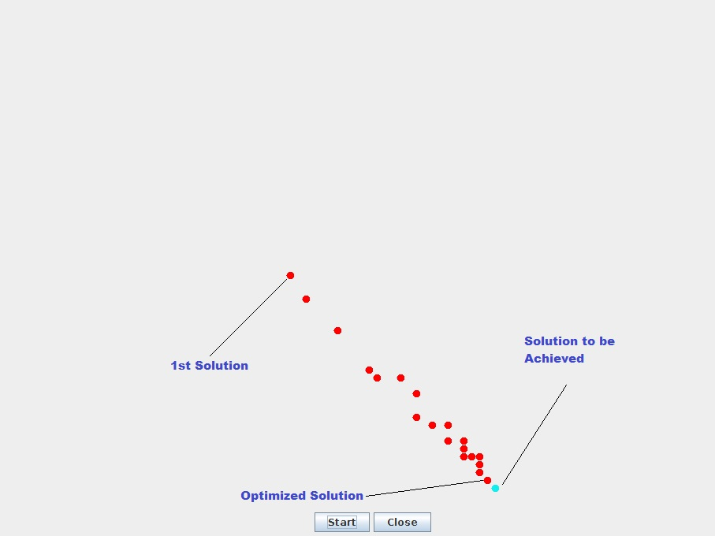
Result using UI

Slide 8
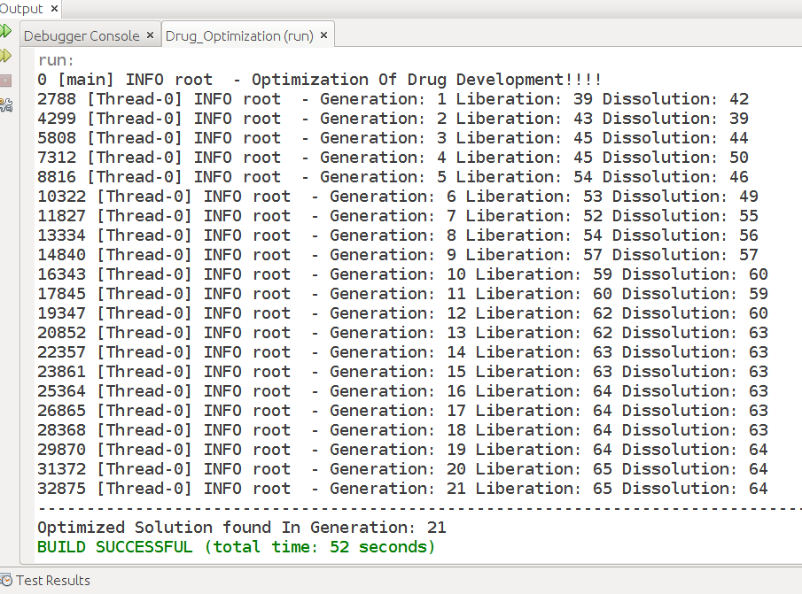
Logs On Console

Slide 9
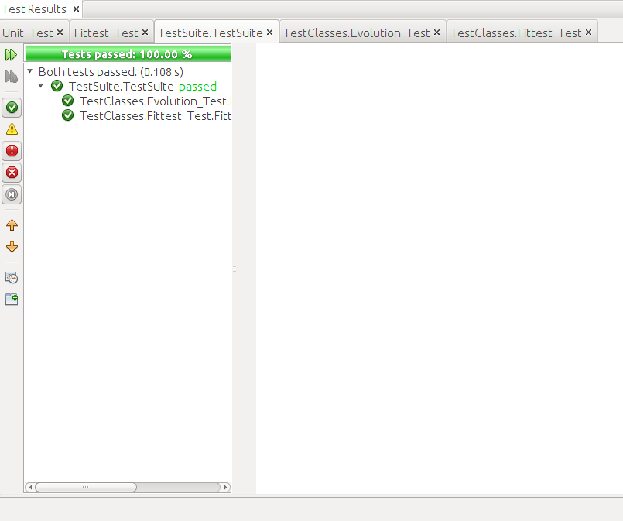
Test Suite

Slide 10
Conclusion
A genetic algorithm (or GA) is a search technique used in computing to find true or approximate solutions to optimization.
It is very efficient, astounishing and are used in many fields.

Slide 11
Thank You

